Slide 1
NADTC Course Session 2:
Coordination and Collaboration
Featuring
Jon Gaffney, Senior Mobility Analyst
Erin McAuliff, Transportation & Mobility Planner
Marin Transit
and
Ana Bagtas, Program Manager
Marin County Department of Health & Human Services,
Aging and Adult Services

Slide 2
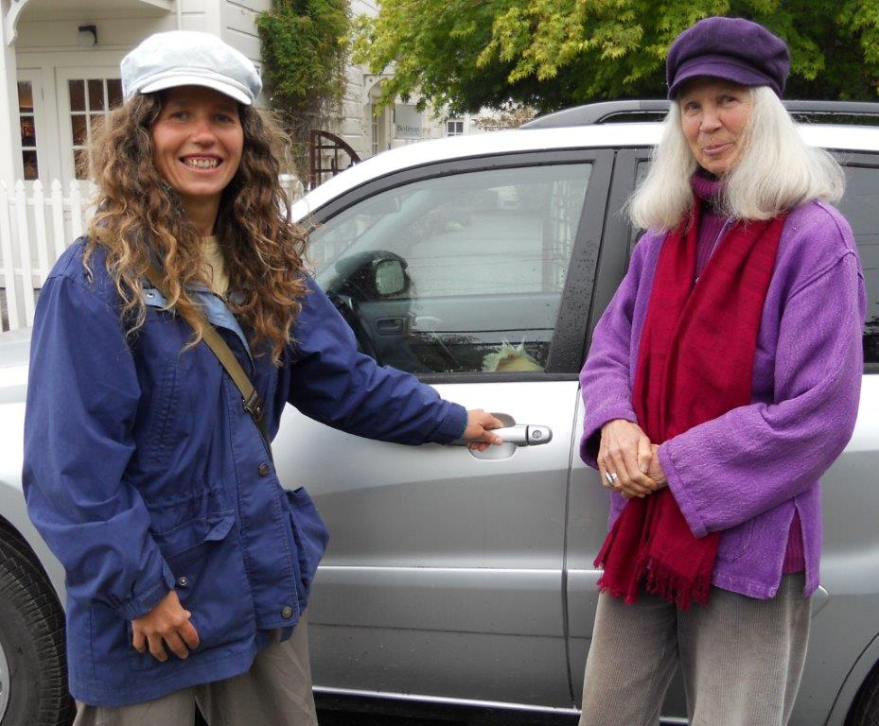
NADTC Human Services Transportation Online Course
January 2017
Ana Bagtas, Program Manager, Marin County Aging & Adult Services
Jon Gaffney, Senior Mobility Analyst, Marin Transit
Erin McAuliff, Transportation & Mobility Planner, Marin Transit
Human Services Transportation Collaboration and Coordination

Slide 3
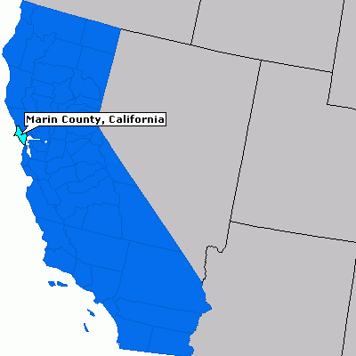
Marin County

Slide 4
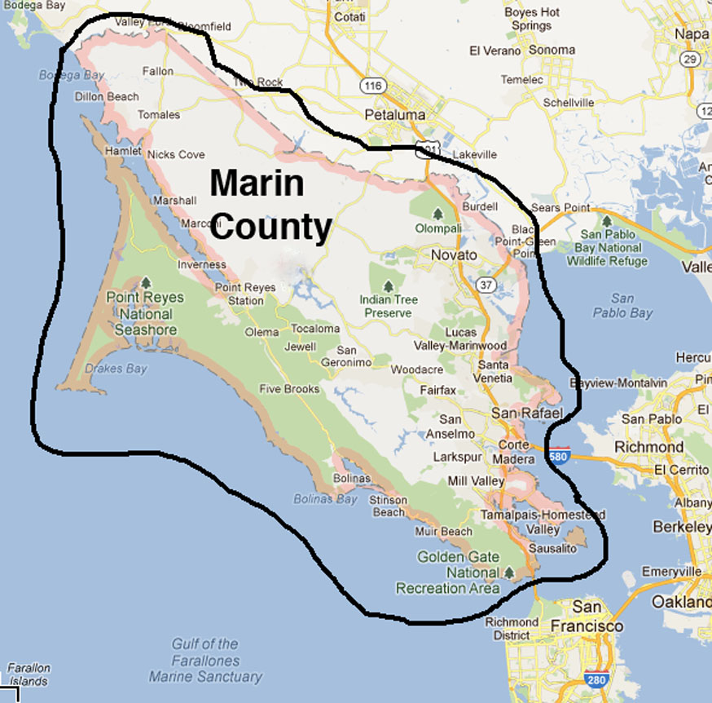

Slide 5
Marin County Demographics

Slide 6
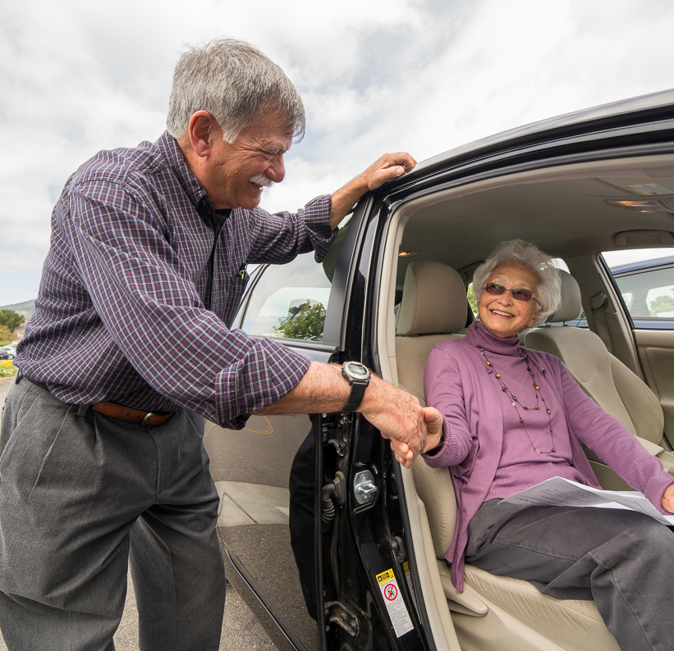
Sample Programs
Assisted Transportation
Case Management
Chore Services
Home Delivered Meals
Congregate Meals
Family Caregiver Support
Marin County Aging and Adult Services

Slide 7
Transportation B.C . (Before Collaboration)
Planning Separately – No Coordination
AAA Needs Assessment Surveys – Transportation in the top 5 identified needs
Only services – Fixed Route and Paratransit

Slide 8
Transportation Programs & Services
for Seniors & People with Disabilities
Marin Catch-A-Ride
Marin Access Paratransit
Travel Navigators
STAR and TRIP Volunteer Driver
Travel Training
Carepool Volunteer Driver
Marin Access
A program of Marin Transit

Slide 9
Planning
Implementing
Sustaining
(on-going)
AAA/Transit Agency Collaboration

Slide 10
Planning
2007 Joint Project CalTrans Grant
Federal Technical Assistance on Design Thinking
2009 Develop Senior Mobility Action & Implementation Plan
AAA/Transit Agency Collaboration

Slide 11
Implementing
2010 Establish Marin Mobility Management Consortium
2010 Passage of Measure B
2011 Identify Volunteer Driver Software
2012 Launch Catch-A-Ride Program
2014 Aging Action Initiative (AAI)
2016 AAI Inform and Connect Presentations
AAA/Transit Agency Collaboration
Notes:
Explain AAI and Marin Transit/transportation is a founding partner.

Slide 12
Sustaining (on-going)
Serve on committees, e.g.:
Marin Mobility Consortium
Commission on Aging Committee on Housing & Transportation
Review RFPs
Help with outreach and cross-promotion of programs
Partner on grant applications
Involve each other in your major planning efforts:
AAA Area Plan
Marin Access Strategic Analysis and Recommendations
AAA/Transit Agency Collaboration
Notes:
Spell out RFP

Slide 13
1. Set the Stage
Create a sense of urgency  pull together the guiding team
2. Decide What to Do
Develop the change vision strategy
3. Make it Happen
Communicate for understanding and buy-in  empower others to act  produce short-term wins  don’t let up
1
2
3
4
4. Make it Stick
Create a new culture
Process for Successful Change
(source: John Kotter)

Slide 14
Resources to Get You Started
Step 1
Identify the players by finding your local:
Area Agency on Aging
Transit agencies
Metropolitan Planning Organization (MPO)
Advocacy groups and research institutions
Step 2:
Use their resources to educate yourself on what they do and what their plans are.
Step 3:
Identify shared community needs and priorities that could be opportunities for collaboration.

Slide 15
Helpful Databases and Member Directories
Transit agency
American Public Transportation Association (APTA)
You will see a tab that says “Find Public Transportation Near You”
www.apta.com
Area Agency on Aging
Eldercare Locator
Search by location to identify your local AAA or Title VI program
http://www.eldercare.gov/Eldercare.NET
MPO
Metropolitan Planning Organization Database
https://www.planning.dot.gov/mpo.asp
Advocacy/Research Institutions
National Alliance of Public Transportation Advocates (NAPTA)
http://www.publictransportation.org/napta/Pages/MemberDirectory.aspx
Step 1: Identify the Players

Slide 16
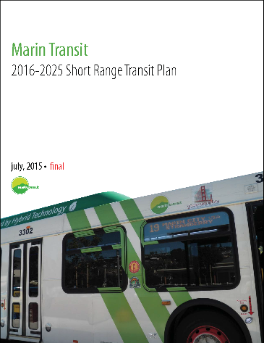
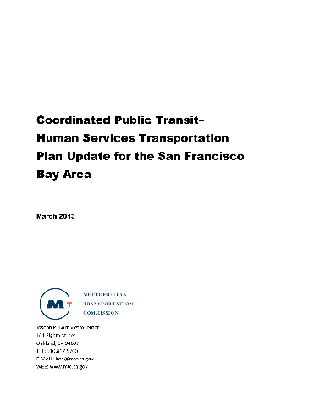
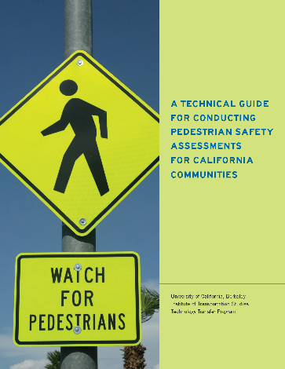
Transit agency
Short Range Transit Plan (SRTP)
Area Agency on Aging
Area Plan
MPO
Coordinated Human Services Transportation Plan
Regional long-range integrated transportation & land-use/housing plan
Advocacy/Research Institutions
Reports, Technical Guides and Legislative Info
Step2: Applicable Resources

Slide 17
National Center for Mobility Management (NCMM)
Resources for Coordination
Coordinated Transportation Strategies
http://nationalcenterformobilitymanagement.org/by-topic-coordination-strategies/
NCMM Regional Liaisons
http://nationalcenterformobilitymanagement.org/ncmm-regional-liaisons/
Resources on Local Coordinated Services
http://nationalcenterformobilitymanagement.org/local-coordinated-services/
Step 3: Coordinate

Slide 18
Questions/Feedback

Slide 19
NADTC Course Session 2:
Coordination and Collaboration
Featuring
Dave Lin, ACC Rides Volunteer Coordinator
ACC Senior Services

Slide 20
ACC Senior Services
501(c)3 non-profit corporation founded in
1972 in Sacramento, CA
Mission: Promote the general welfare and enhance the quality of life for our community by identifying, developing, and providing culturally sensitive health and social services for older adults.
Vision: Create an array of services that help older adults sustain their independence, health and lifestyles

Slide 21
ACC Senior Services Community Programs
Lifelong Learning and Wellness Program
-Dance and Fitness, Arts & Culture, Computers
Bridge to Healthy Families Caregiver Support
-Care Management, Friendly Visitors, respite scholarship
Utilities Education &
Assistance
ACC Rides Transportation
Services

Slide 22
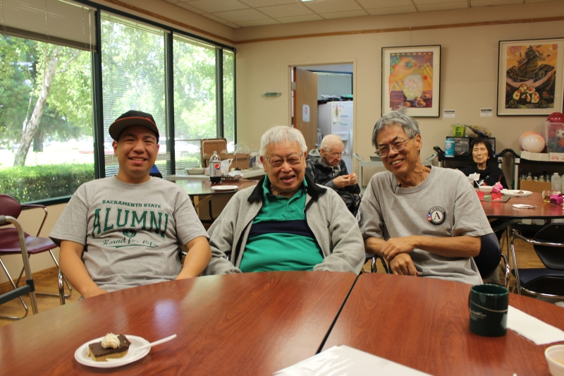
ACC Rides Transportation Service
Survey of family caregivers conducted
Greatest needs:
Participant rides to respite programs
Family transportation to nursing homes
Medical appointments
Neighborhood errands and personal trips
Shopping trips

Slide 23
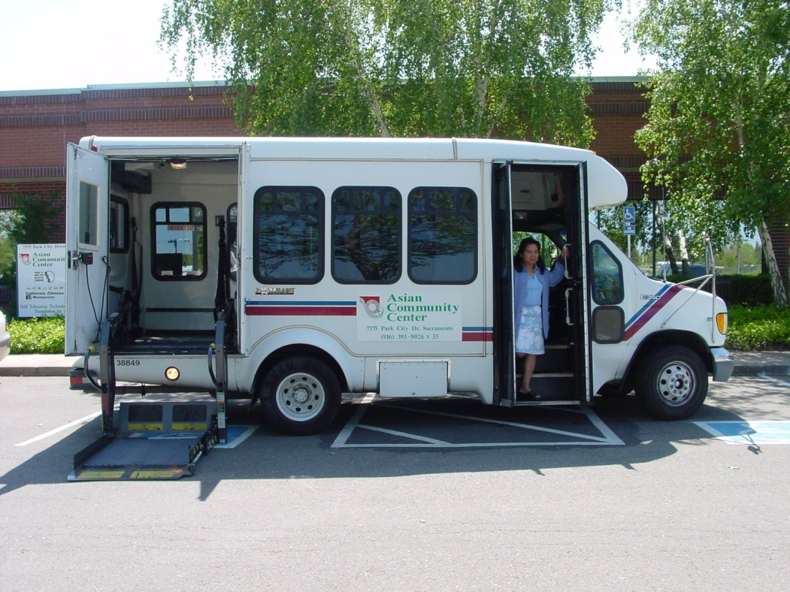
ACC Rides Program Launch
Program launched in 2003
$25,000 grant awarded by Area 4 Agency on Aging
One 8-passenger bus
Six volunteers
One staff member
Paratransit assistance:
Bus
Training
Fuel and maintenance

Slide 24
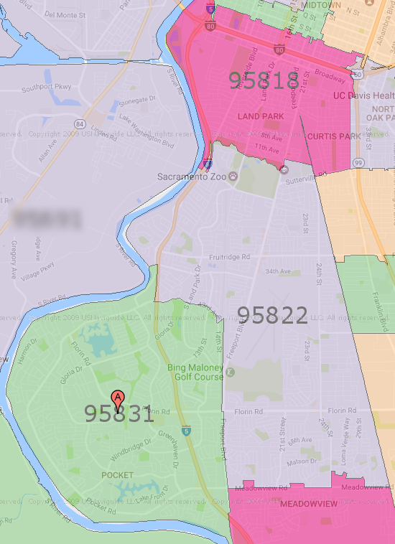
ACC Rides Initial Service
Three zip codes
95831
95822
95818
$1.50 donation

Slide 25
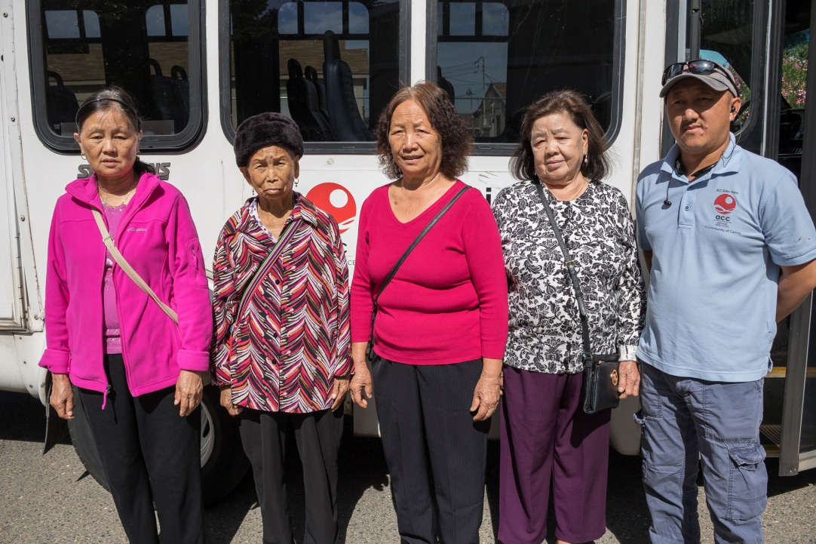
Outreach to Non-English Speaking Community
Additional agreement with Paratransit in 3rd year
Focused on non-English speaking clients
ACC Rides made bilingual staff and volunteers available
Paratransit would cover project costs

Slide 26
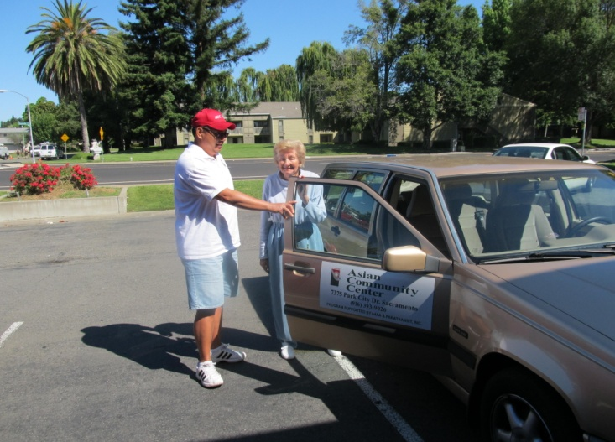
ACC Rides Volunteers
87 volunteer drivers, driver’s assistants, dispatchers, schedulers and administrative assistants
Recruited primarily by word-of-mouth referrals and online
Volunteer appreciation luncheon

Slide 27
ACC Rides Volunteer Coordinator
Hired using FTA 5310 grant funding
Recruits, trains and manages ACC Rides volunteers
Continuing education through online seminars and local organizations

Slide 28
ACC Rides Awards
2015 WTS Rosa Parks Diversity Leadership award
2012 Aging Services of California (now LeadingAge California) Volunteer of the Year
2009 Heroes in Human Services Award
2008 Beverly Foundation Star Award
Metlife Foundation Older Volunteers Enrich America Award

Slide 29
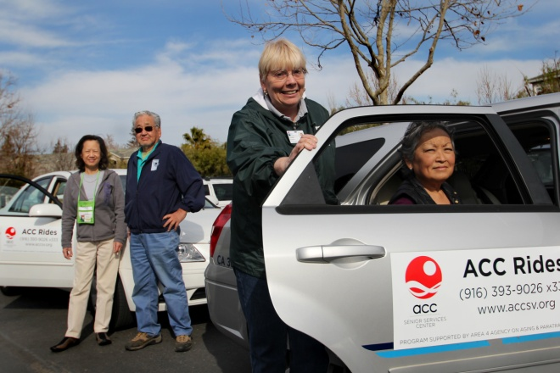
ACC Rides Today
Transportation to senior meal sites, ACC programs, grocery stores, medical appointments & errands
High standards for service have resulted in consistent and growing business and volunteer base.

Slide 30
ACC Rides Today
Continued support of several organizations
Agency on Aging/Area 4
FTA
Caltrans
SACOG
Teichert Foundation
Paratransit, Inc.
Ann Land & Bertha Henschel Memorial Fund

Slide 31
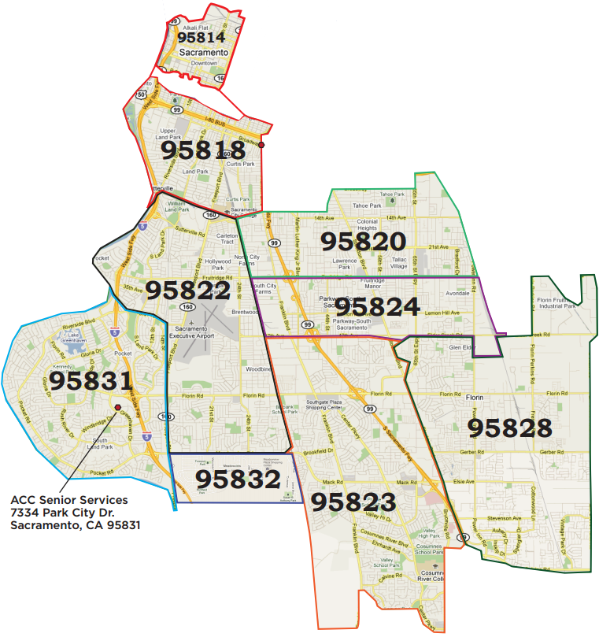
ACC Rides Today
Over 40,000 one-way rides annually
87 active volunteers
14 full-time staff
16 vehicles
Nine zip code service area, and Delta region communities
$5.00 donation per ride

Slide 32
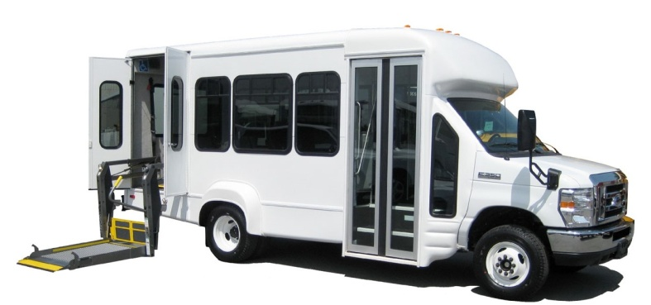
ACC Rides Tomorrow
Four new ADA minivans in 2017
Paratransit vehicle upgrades
Planned service expansion
Upgrade of current scheduling and CRM system
Continue current funding and in-kind support, and efforts to secure new sources

Slide 33
ACC Rides Transportation Services
ACC Rides/ACC Senior Services
7334 Park City Drive
Sacramento, CA 95831
Telephone: (916)393-9026
Fax: (916)393-9128
Email: rides@accsv.org
Web: www.accsv.org
www.facebook.com/accsv
www.twitter.com/ACCSeniorSvcs
www.youtube.com/user/accseniorservices

